Slide 1
IBM University Engagement Project Submission
“Exploring the Power of Agentic AI with IBM Granite and LangFlow”

Slide 2

Project Title: LearnMate – AI Career Assistant
Domain of Project – Education
Student Name | Recent Passport Photo | Email ID | Mobile number [WhatsApp]
Mohammed Abdul Rahman |  | rahmanabdulmohammed15 @gmail.com | 9963990074

Slide 3
Problem Statement -
Problem Statement : Agentic AI for Personalized Course Pathways
The Challenge
Students often struggle to identify the right learning path that aligns with their interests and long-term goals due to the overwhelming number of online courses and a lack of personalized guidance. LearnMate aims to solve this by acting as an Agentic AI coach that understands students, understands their interests (like Frontend Development, Cybersecurity, UI/UX Design, etc.), assesses their current skill level, and dynamically builds a personalized course roadmap that adapts over time based on progress and preferences.
Objective
The objective of LearnMate – AI Career Assistant is to help students identify suitable career paths and learning opportunities based on their interests, skills, and goals. The system uses IBM watsonx.ai, IBM Granite Models, and Agentic AI to generate personalized learning roadmaps, recommend relevant courses, and provide career guidance. It aims to reduce confusion caused by the large number of available learning resources and enable students to make informed career decisions through an intelligent and interactive AI assistant.
Key Objectives:
Provide personalized career guidance.
Generate customized learning roadmaps.
Recommend relevant courses and skill-development resources.

Slide 4
Technology Used
Tech Stack -
LangFlow – Used to design and connect the AI workflow visually.
IBM watsonx.ai – Used to access and run foundation models.
IBM Granite Models – Used for generating career guidance and personalized learning roadmaps.
Agentic AI – Used to provide interactive and intelligent career assistance.
Prompt Engineering – Used to create effective prompts for accurate responses.
GitHub – Used for project documentation and repository management.
I used LangFlow + IBM watsonx.ai + IBM Granite Models + Agentic AI

Slide 5
Proposed Solution -
Proposed Solution: LearnMate is an AI-powered career and learning assistant that provides personalized learning roadmaps based on user interests, career goals, and current skill levels.
The system:
Collects user interests and goals
- Analyzes skill levels
- Generates customized learning pathways
- Suggests courses, certifications, and resources
- Provides career guidance using IBM Granite models
The solution is built using LangFlow and IBM watsonx.ai to deliver intelligent and adaptive learning recommendations.

Slide 6
Langflow component Used –
Chat Input Interface where users enter their career interests, skills, and learning goals.
2) Prompt Template Structures user input into a predefined prompt format for generating personalized career guidance.
3) IBM watsonx.ai Component Processes user queries using IBM Granite foundation models and generates intelligent responses.
4) IBM Granite Model (ibm/granite-4-h-small) Provides AI-powered career recommendations, learning roadmaps, and skill development guidance.
5) Chat Output Displays AI-generated responses, career suggestions, and personalized learning paths.
6) LangFlow Visual Workflow Connects all components and manages the flow of information between input, AI processing, and output.
Since you did not use a File/Knowledge Base component in your final workflow, don't mention it. Only include the components actually used in your project.

Slide 7
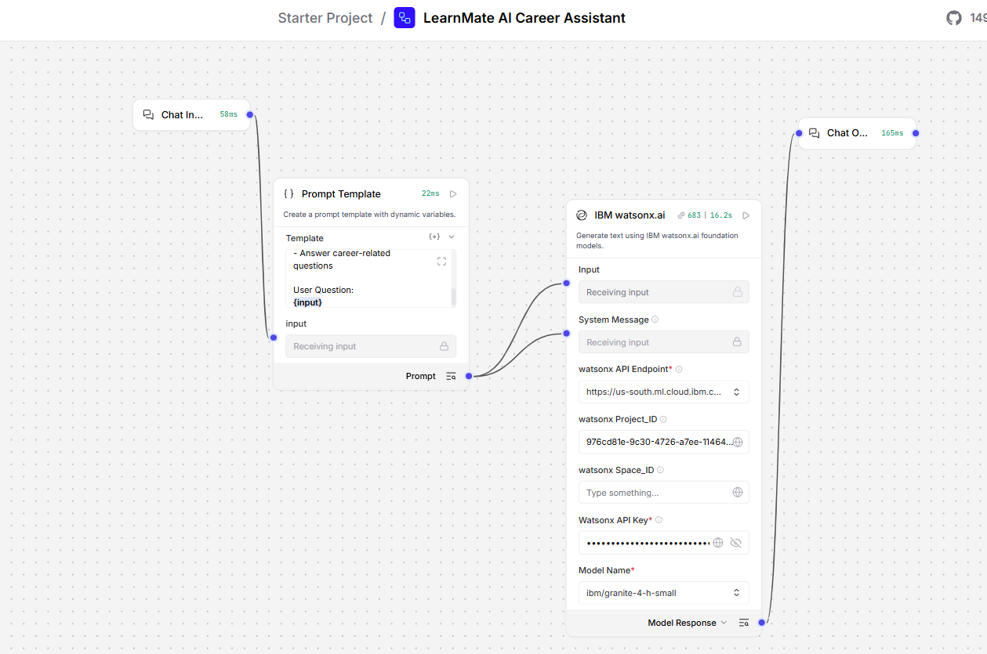
Langflow workflow -

Slide 8
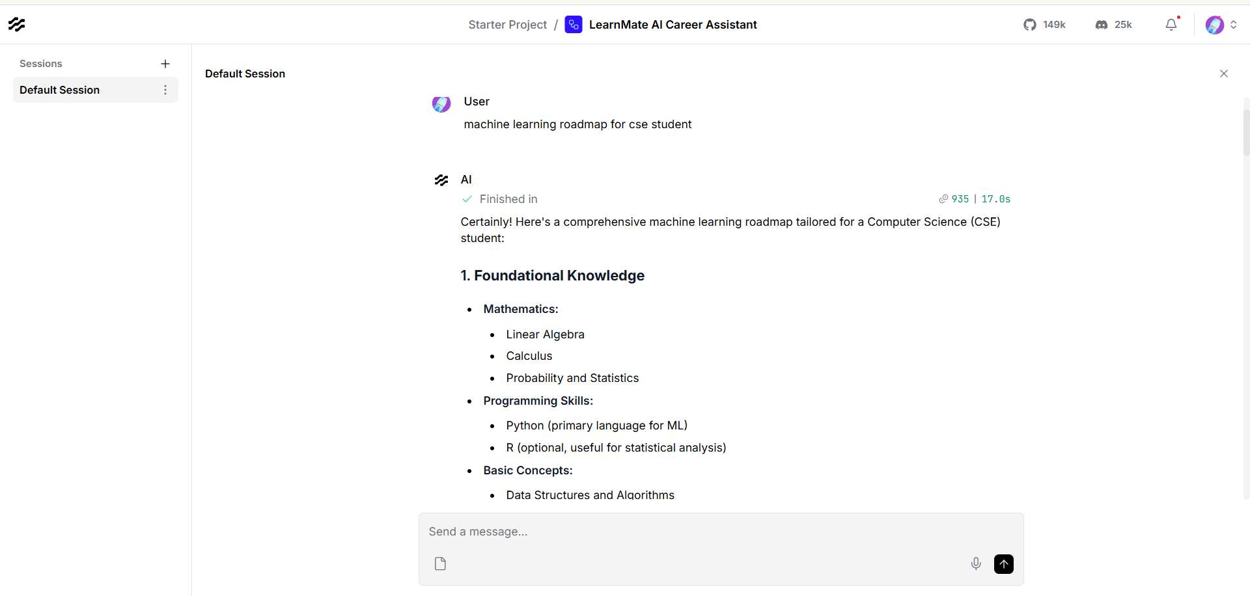
Langflow Playground

Slide 9
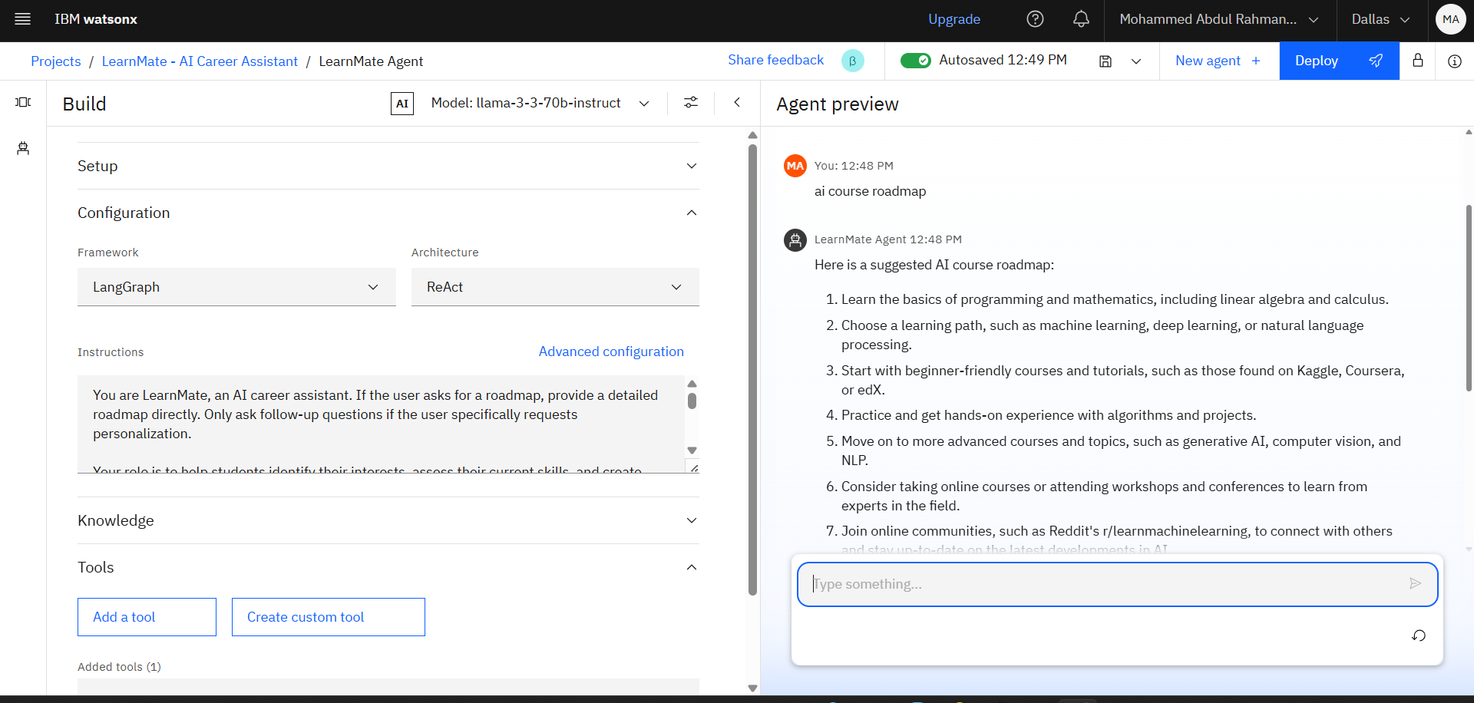
LearnMate Agent

Slide 10
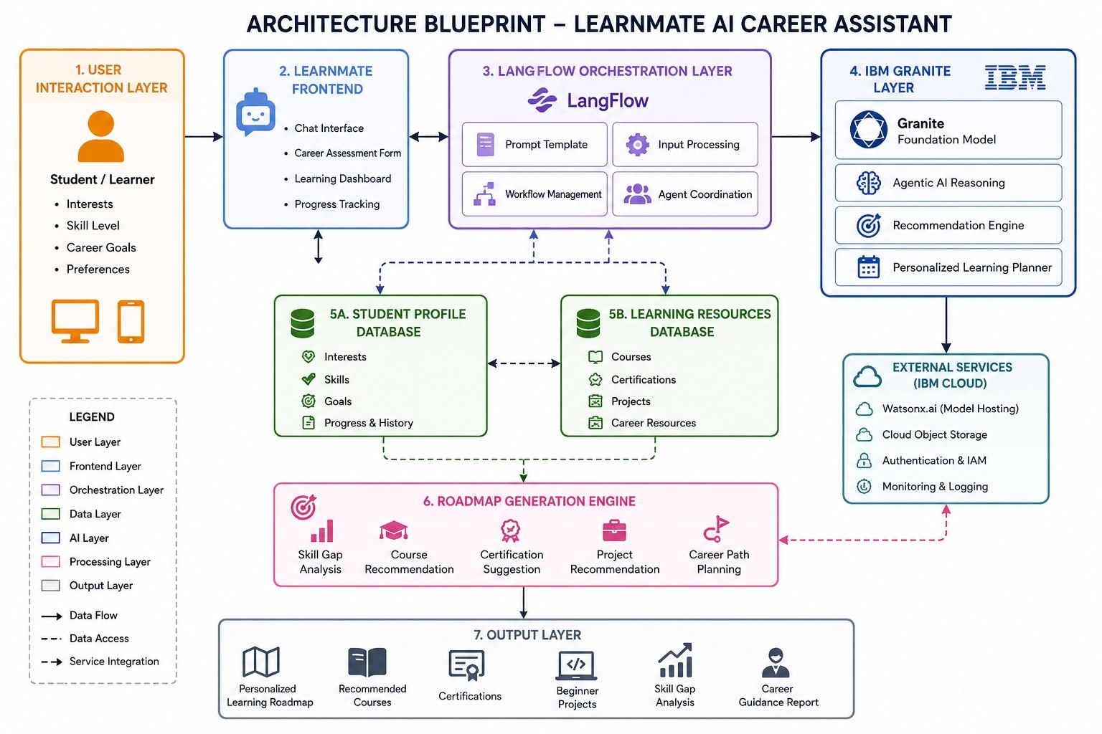
Architecture blueprint -

Slide 11
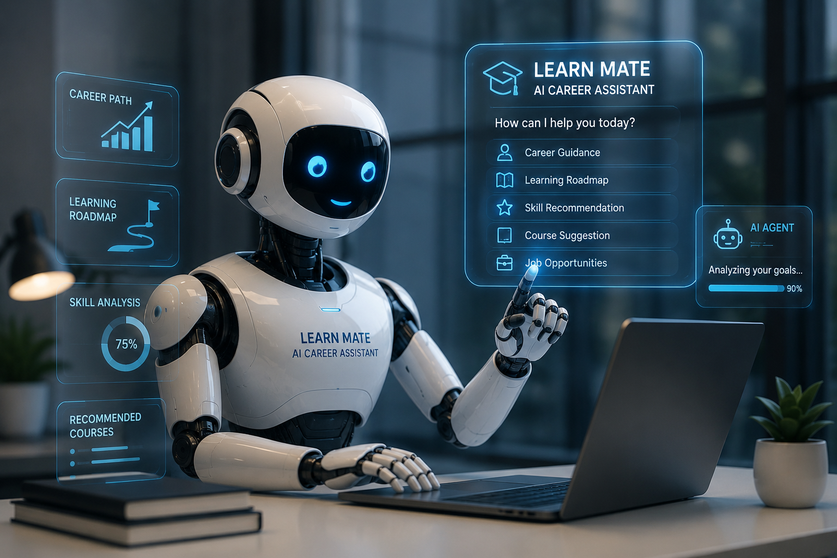
Role of Agentic AI in the solution
Agentic AI acts as the intelligent decision-making engine of LearnMate – AI Career Assistant. Instead
of providing generic answers, it analyzes user inputs such as interests, skills, learning preferences, and career goals to deliver personalized guidance.
Key Roles of Agentic AI -
Personalized Career Guidance
Understands user interests and recommends suitable career paths.
Dynamic Learning Roadmaps
Creates customized learning plans based on the user's current skill level and goals.
Intelligent Decision-Making
Evaluates user requirements and generates relevant course and skill recommendations.
Interactive AI Mentor
Engages in natural conversations and answers career-related queries in real time.
Goal-Oriented Assistance
Helps users identify skill gaps and suggests actions to achieve career objectives.
Continuous Adaptation
Adjusts recommendations based on new user inputs and changing preferences.
Conclusion
Agentic AI enables LearnMate to function as a personalized virtual career mentor that guides
users in choosing career paths, acquiring skills, and achieving their professional goals
through intelligent and adaptive recommendations.
Role of Agentic AI in LearnMate - Agentic AI for Personalized Course Pathways

Slide 12
Technology Used -
LangFlow – Visual workflow builder for designing AI agent pipelines.
IBM watsonx.ai – Foundation model platform used for AI inference and response generation.
IBM Granite Models (ibm/granite-4-h-small) – Large Language Model used for career guidance and roadmap generation.
Agentic AI – Enables intelligent decision-making and personalized recommendations.
Prompt Engineering – Structures user queries to improve AI responses.
GitHub – Version control and project repository management.
IBM Cloud Lite – Cloud platform used to access IBM AI services.

Slide 13
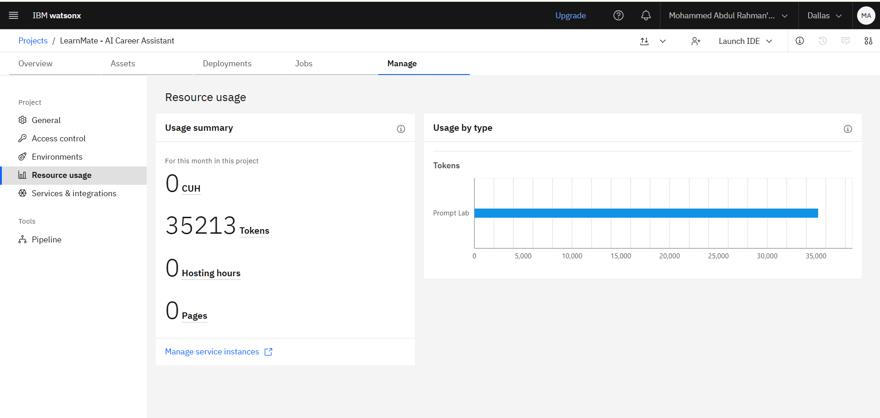
Tokens

Slide 14
Novelty and Uniqueness
Novelty & Uniqueness of LearnMate – AI Career Assistant
1. Agentic AI-Based Career Mentor
Unlike traditional chatbots that provide generic answers, LearnMate acts as an intelligent AI agent that understands user goals, interests, and skill levels to provide personalized career guidance.
2. Personalized Learning Roadmaps
The system dynamically generates customized learning pathways based on the user's career aspirations.
3. IBM Granite Powered Intelligence
LearnMate leverages IBM Granite Models through IBM watsonx.ai to deliver accurate goal-oriented recommendations.
4. Interactive Career Decision Support
The platform helps users identify suitable career paths such as:
AI & Machine Learning
Data Science
UI/UX Design
and suggests the required skills for each path.
5. Skill Gap Identification
The AI analyzes the user's current skills and highlights missing competencies required to achieve their desired career goals.

Slide 15
Git Hub Link -
https://github.com/mohdrahman-ai/LearnMate-AI-Career-Assistant
·
·
·

Slide 16
Future Scope
Integration with Online Learning Platforms
LearnMate can be integrated with platforms such as Coursera, edX, Udemy, and IBM SkillsBuild to automatically recommend relevant courses and certifications.
2. Skill Assessment and Progress Tracking
Future versions can include quizzes, assessments, and progress tracking dashboards to monitor users' learning journeys and skill development.
3. AI-Powered Resume and Portfolio Builder
The system can generate professional resumes, portfolios, and LinkedIn profile suggestions based on user skills.
4. Job and Internship Recommendations
LearnMate can be enhanced to provide personalized job, internship, and placement opportunities based on user profiles and career goals.
5. Multi-Language Support
Adding support for multiple languages will make the platform accessible to a wider audience.
6. Voice-Based Career Assistant
Voice interaction capabilities can enable users to communicate naturally with the AI assistant using speech commands.
·
·
·

Slide 17


